Slide 1
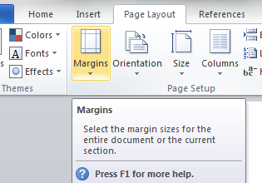
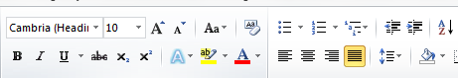

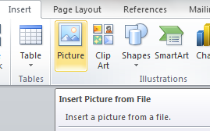
Chapter 17: Document Production (Word)
Task 6
1. Using a suitable software package, load the file ANGLING.RTF 2. Save this document with a new file name. 3. Set the page size to A4 and the orientation to portrait. 4. Set the Margins to: Top margin to 3.5 centimetres and bottom margin to 2 centimetres Left and right margins to 1.5 centimetres. 5. Place the image LOGO.JPG on the right in the header. 6. Resize the image to 2.5 centimetres high and maintain the aspect ratio. 7. Place in the footer: The automated file name and file path left aligned Your name and candidate number right aligned 8. At the start of the document enter the title COARSE FISHING IN THE UK and apply style. 9. Below the title, add a subtitle and apply style: Beginners guide by: and add your name.
House Style Specification Sheet Title: Serif, Bold, 30pt, Right Aligned Subtitle: Serif , Italic, 18pt, Underlined, Centre aligned Subheading: Serif, 14pt, Centre Aligned and one clear line space after each subheading. Body Text: Sans Serif, Black, Single Line Spacing, 11pt and Fully Justified. One clear line space after each paragraph.

Slide 2
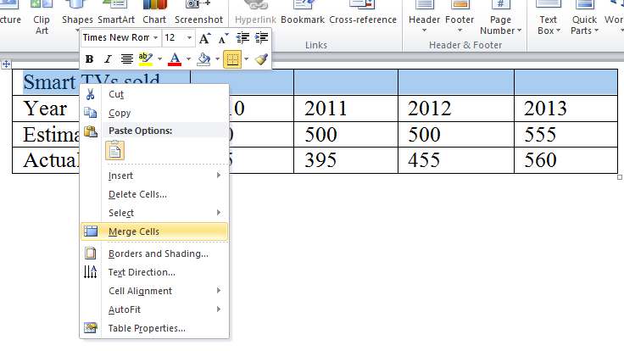
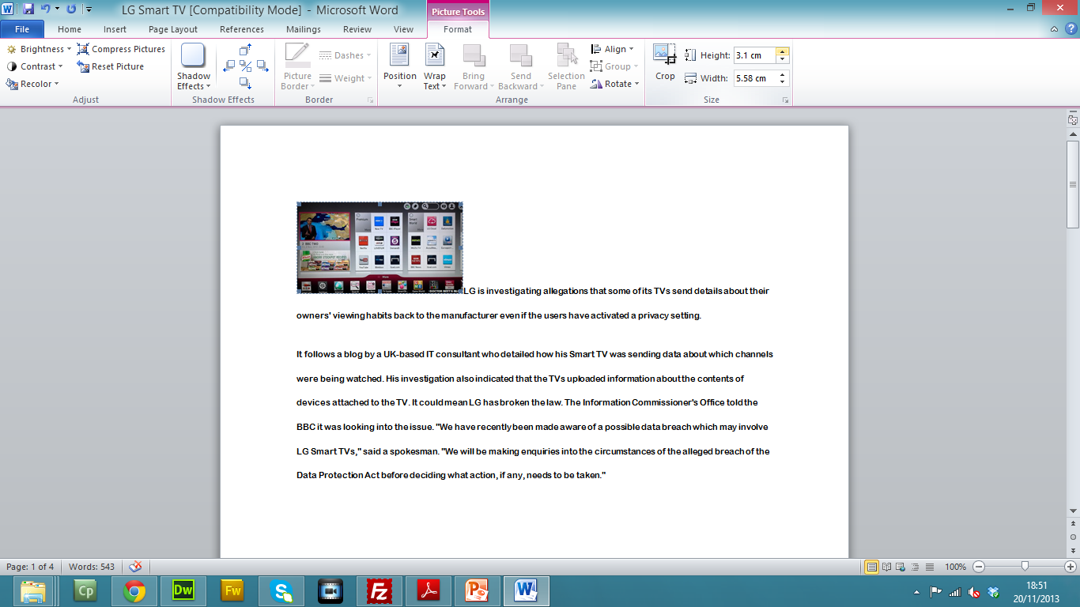
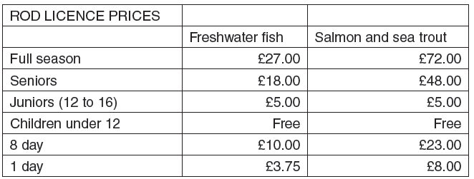
Chapter 17: Document Production (Word)
Task 6
10. Format the text from the subheading Types of Angling so that all following text is displayed in two equally spaced columns with 2 centimetre spacing between the columns. Apply the body text style to all text. 11. Identify all the subheadings (7) in the document and apply style. 12. Insert a table with 3 columns and 8 rows after the text …must have a rod licence. 13. Enter the following data into the table: 14. Format the text in the table as body text. 15. Format the top row of the table to be: Merged, Centre aligned, Bold and Underlined. 16. Format the second row of the table to be: Italic, Right aligned and headings wrapped. 17. Format the table so the gridlines are not displayed when printed and it fits within the column width.

Slide 3
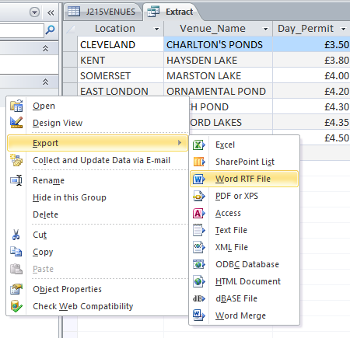
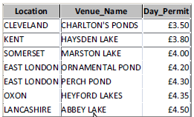
Chapter 17: Document Production (Word)
Task 6
18. Sort the list of freshwater fish from: Bream… to …Tench so it is displayed in alphabetical order. 19. Apply bullet points to this list. 20. Format the list so the bullet points are positioned 2 centimetres from the left margin. 21. Replace the word regulations with the word rules wherever it occurs. 22. Produce an extract from all the data from the Venue database which: Selects only those records where: The name of the venue contains the word lake or pond Day_Permit costs £4.50 or less The water is less than 6 feet deep Shows only the fields Location, Venue_Name and Day_Permit in this order Sorts the data into ascending order of Day_Permit 23. Save this data in a form which can be imported into a Word Document. 24. Import this data into your document as a table after the paragraph which ends: …starter venues include: 25. Spell-check and proof-read the document. 26. Make sure all formatting is consistent throughout your document.

